Slide 1
VY_12_INOVACE_AJ_I_23
P ř e d s t a v e n í
Notes:
inovace_54

Slide 2
Read about Petra.

Slide 3
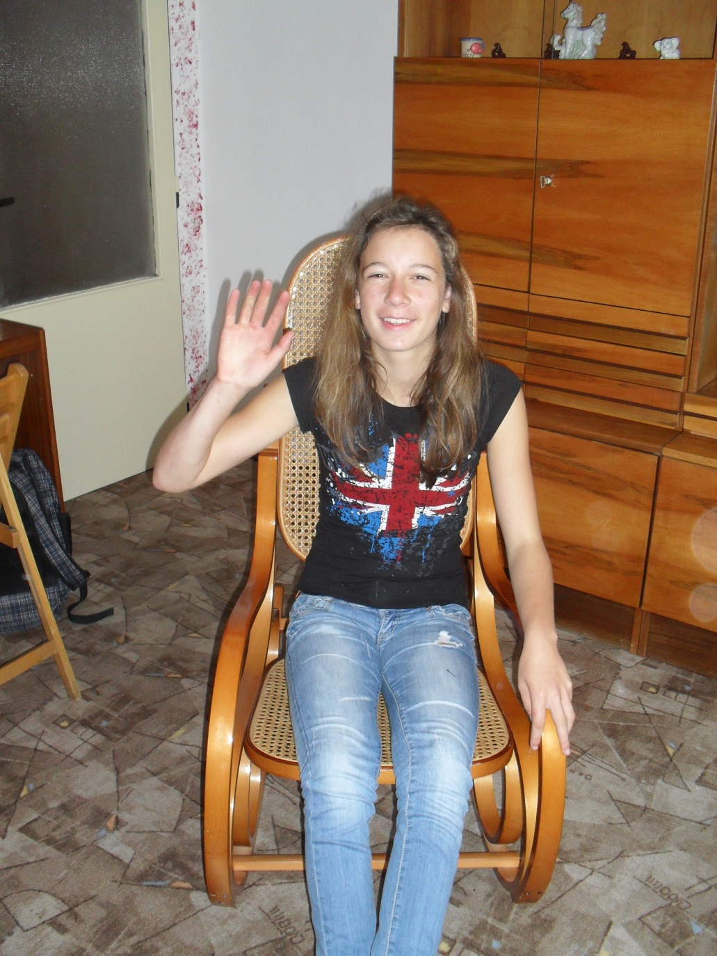
Hello, my name is Petra.
I am thirteen.

Slide 4
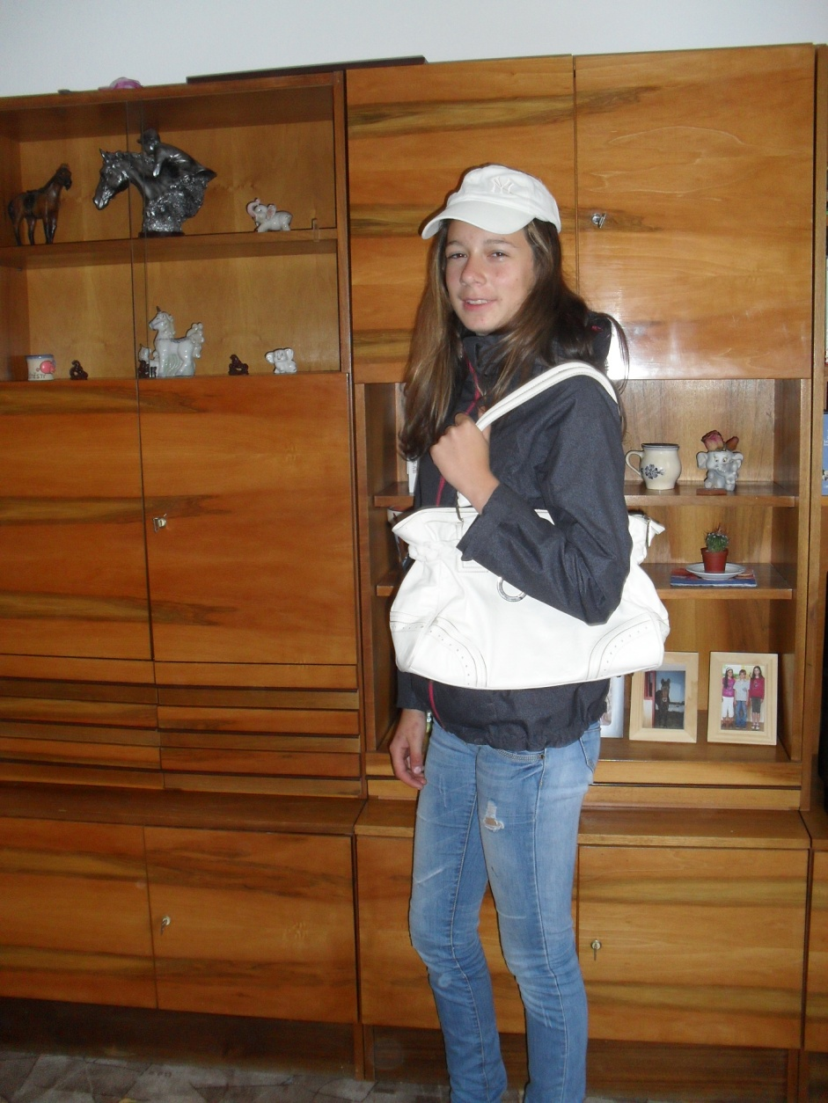
I am a girl.
I am tall and slim.

Slide 5
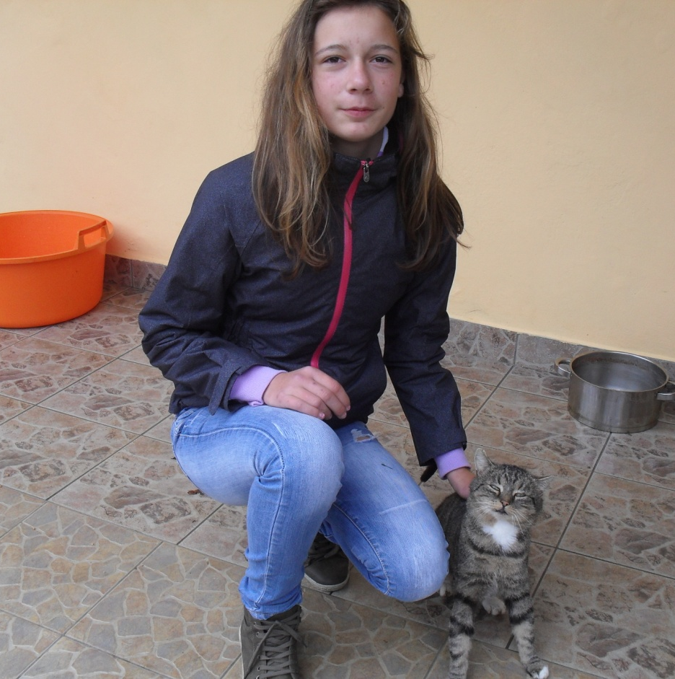
This is Mourek,
my cat.

Slide 6
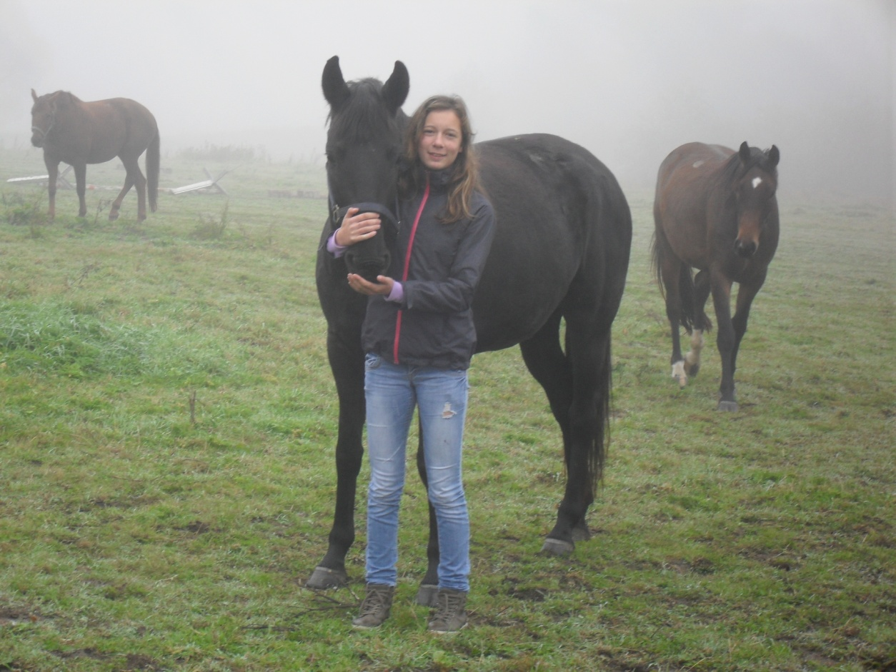
I like horses.
This is my horse.

Slide 7
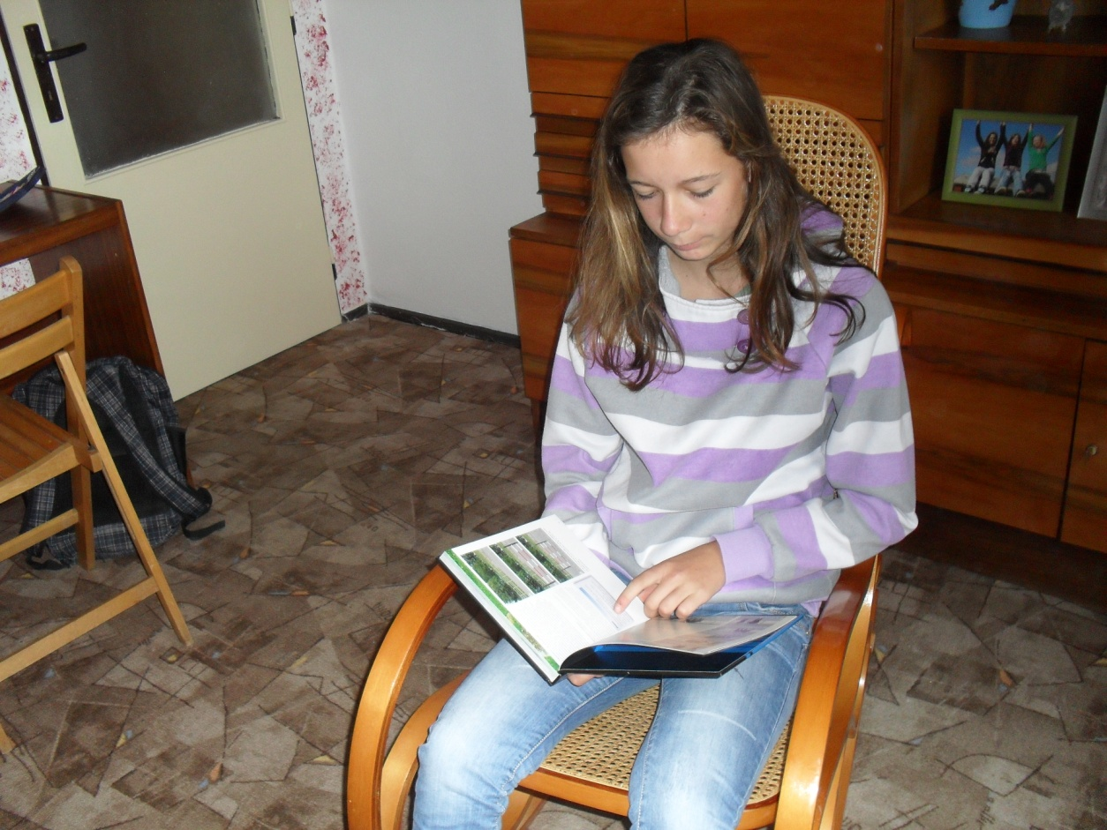
I like reading.

Slide 8
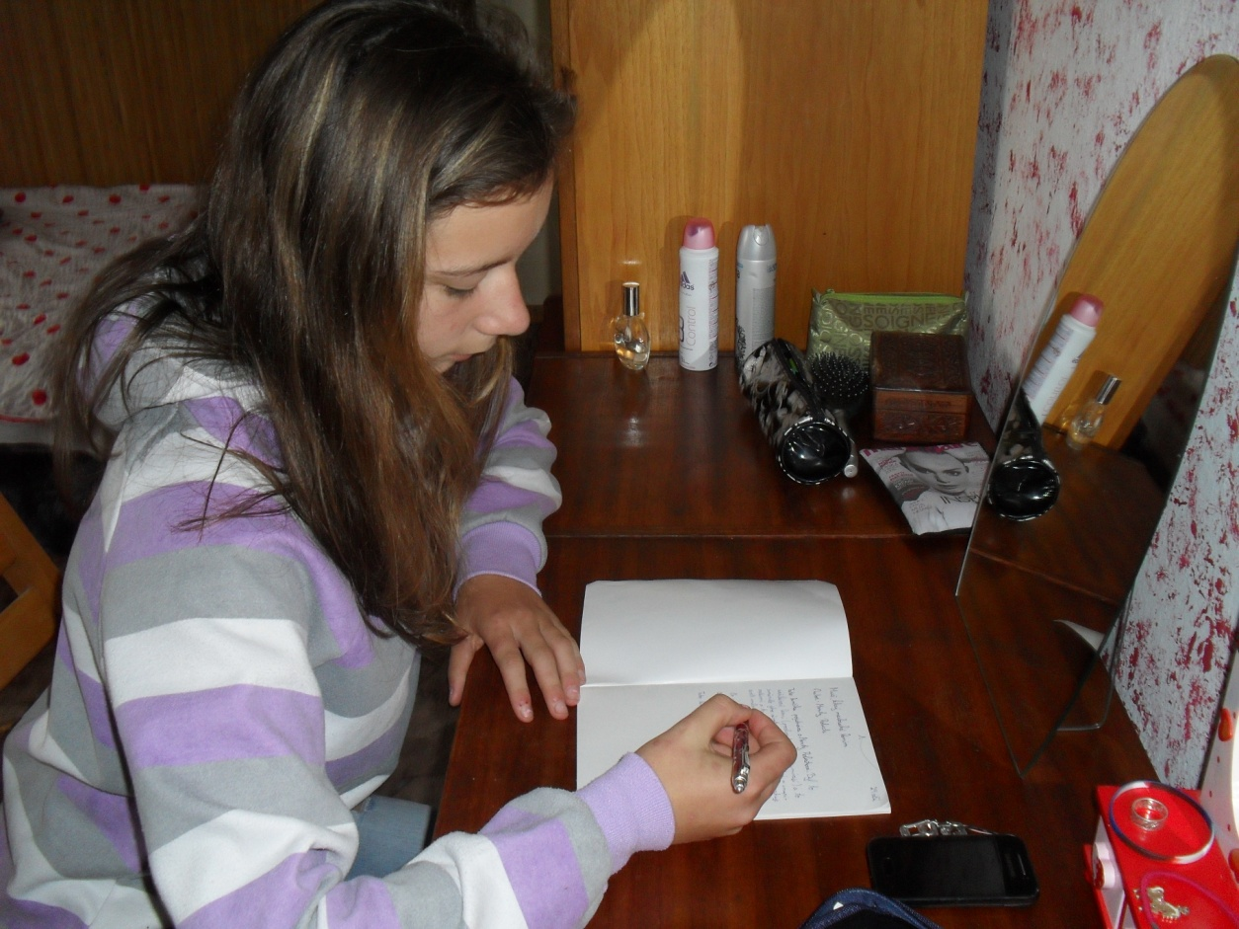
I don´t like my homeworks.

Slide 9
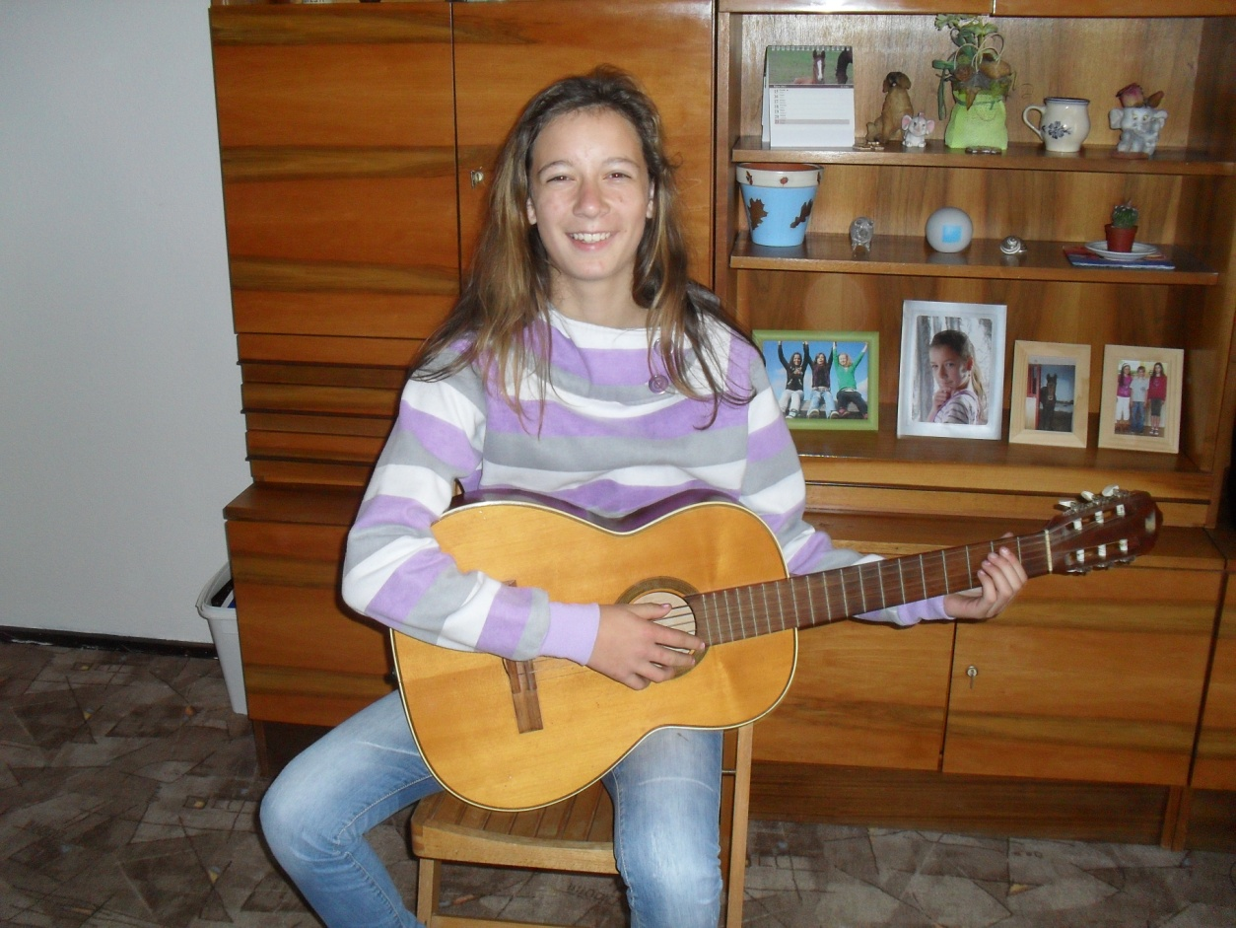
I play the guitar.

Slide 10
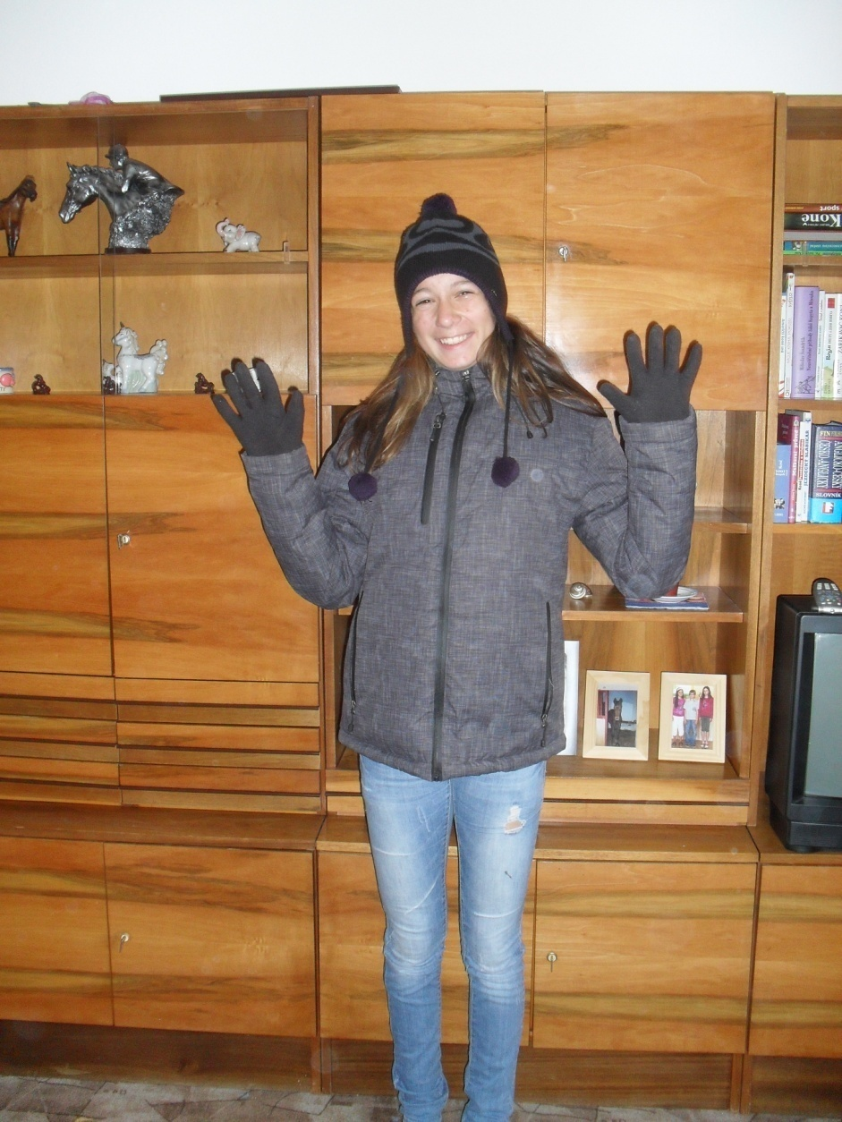
This is me.
And now answer the question about me.

Slide 11
1. How old is she?

Slide 12
2. Has she got any animal?

Slide 13
3. Is she small?

Slide 14
4. What does she like?

Slide 15
5. Does she like her homeworks?

Slide 16
6. Does she like horses?

Slide 17
7. Does she play any musical instrument?

Slide 18
Řešení: 1. She is thirteen. 2. She has a cat and a horse. 3. No, she is not. 4. She likes horses and reading. 5. No, she doesn´t. 6. Yes, she does. 7. Yes, she does. She play the guitar.

